Slide 1
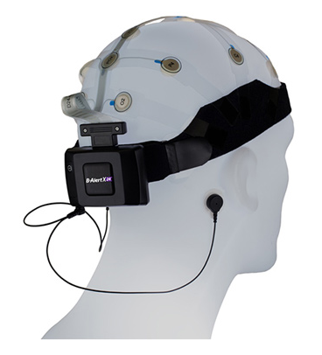
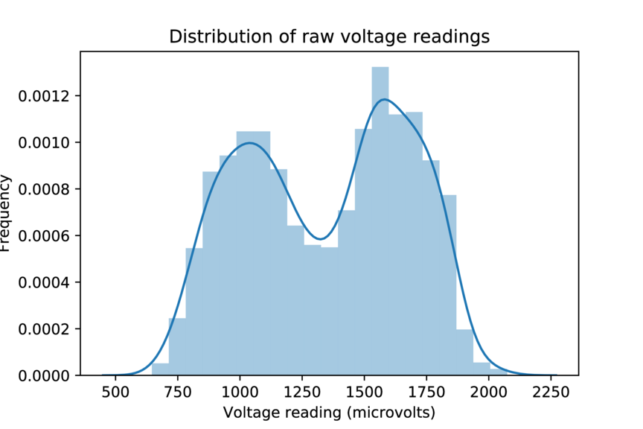
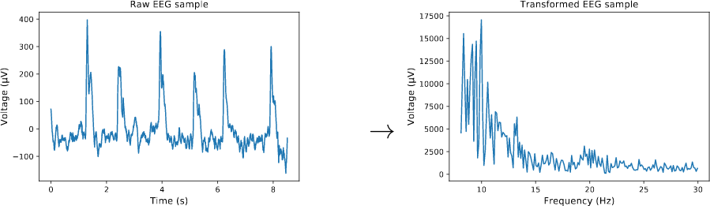
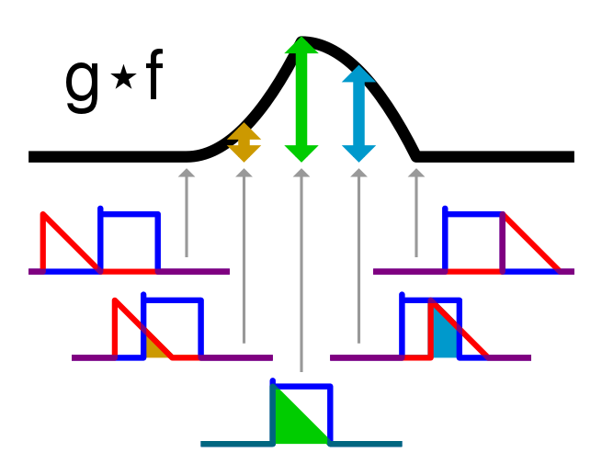
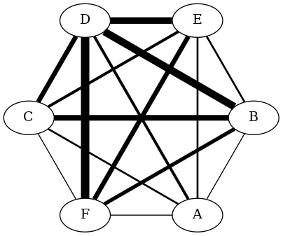
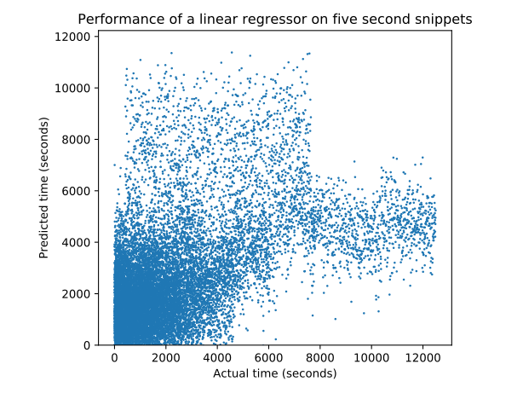
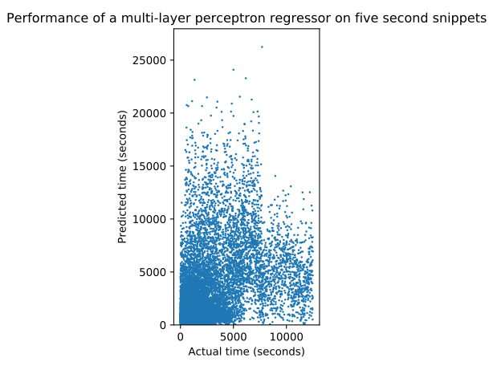
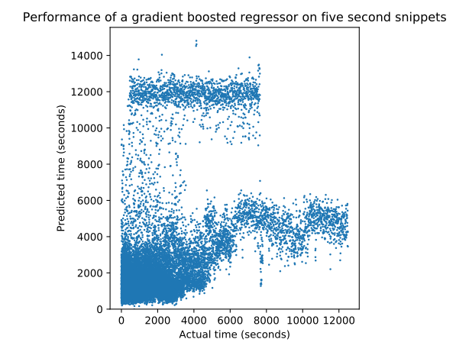
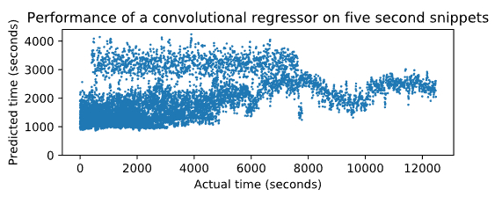
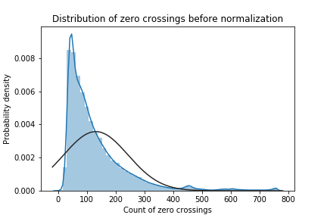
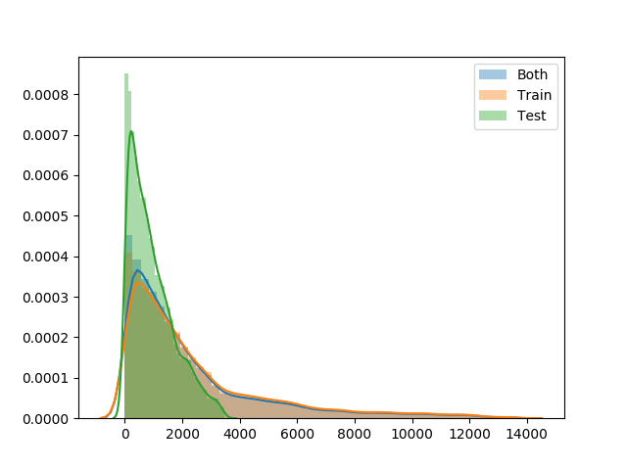
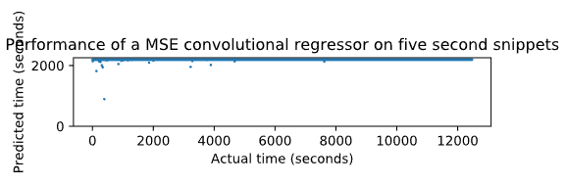
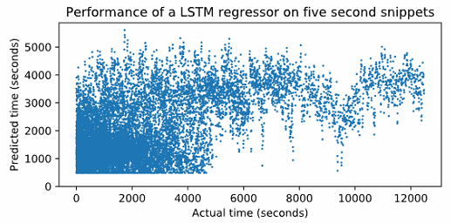
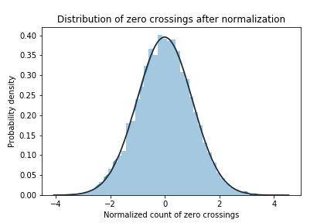
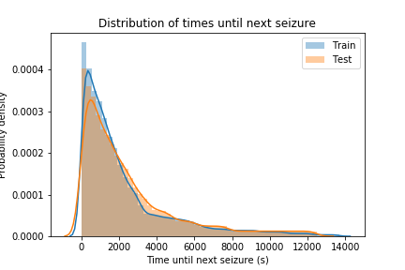
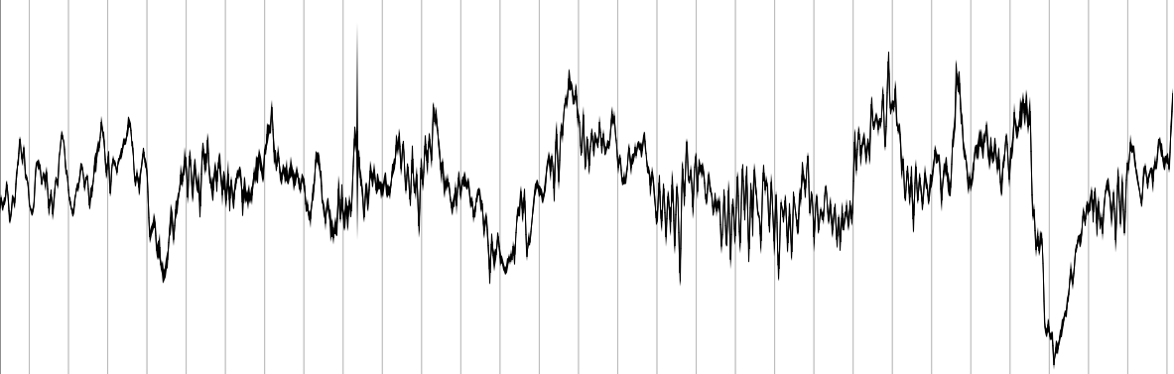
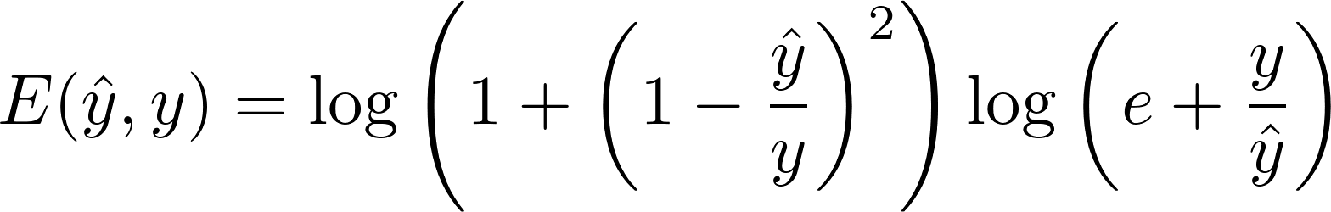
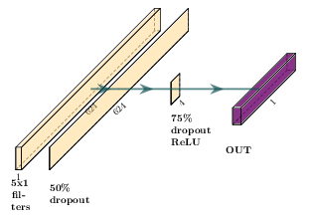
Purpose
Convolutional neural network models for real-time seizure forecasting
Data/Results
Epilepsy is a serious problem, mainly because it’s so unpredictable
What if people with epilepsy had a device that could tell them how long they had until a seizure began?
The hardware exists; we aim to provide the software
Method | R²
Dummy | -0.184
Linear regression | +0.128
Multilayer perceptron | -0.608
Gradient-boosted trees | -0.499
Convolutional neural network (MSE loss) | -0.013
Convolutional neural network (custom loss) | +0.105
LSTM (custom loss) | +0.242
Features
Source: Advanced Brain Monitoring
https://www.advancedbrainmonitoring.com/xseries/x24/
Background
By Cmglee - Own work, CC BY-SA 3.0, https://commons.wikimedia.org/w/index.php?curid=20206883
Biology
Seizures occur when a defective cluster of neurons sends an unusually strong signal, causing a positive feedback loop that spreads across a larger brain region, resulting in a seizure.
If we look at brain activity for signs of future abnormality, we may be able to predict an upcoming seizure. (Stringer, 2017)
EEGs
Electroencephalograms (EEGs) are recordings of the differences in voltage between pairs of electrodes.
Each pair of electrodes measures one channel.
Electrodes can be either intracranial (implanted within the head) or extracranial (attached to the scalp) (Kuruvilla, 2003)
Typically, seizure prediction algorithms begin by picking out a number of features that previous research have shown to be related to seizure occurrence.
Current Research
State of the art algorithms (Tsiouris et al., 2018) can predict whether a seizure will occur in a long segment with near-perfect accuracy; however, we aim to predict a specific time until the next seizure.
Our feature set is derived from Tsiouris et al. (2018), with only small modifications. Broadly, these features cover four categories:
Moments (since these can capture shifts in the distribution of the voltage differences)
Frequency domain features (since neuron firings, and hence brain activity, is largely cyclical)
Correlation-based features (since seizures start with correlation drops)
Connectivity graph-based features (since these capture the higher-level correlations)
Further preprocessing
Since neural networks aren’t scale-invariant, we normalized all our features before feeding them in. Since many of our features did not resemble normal distributions, we used a quantile mapping to transform them.
To avoid giving the models an unrealistic advantage, we had to split between training and testing seizures, rather than snippets. The small size meant we had to select training and testing so that their targets did not have significantly different distributions.
Conclusion
Convolutional neural networks
As the graphs above show, we have so far been unsuccessful at creating an effective model. There are a number of potential causes:
We chose hyperparameters, layer sizes, and other features of our model poorly
The unusual target distribution makes a pure regression ineffective, but possible in principle
It’s effectively impossible to predict the amount of time until the next seizure.
We are currently working on the following:
Survival analysis
Using an autoencoder for preprocessing
Increasing the number of convolutional layers
Switching our architecture to LSTMs
Our convolutional network model takes as input a sequence of 5 624-element feature vectors, each of which is associated with a 5 second snippet of EEG. It then passes through a sequence of layers shown on the left. There are several notable attributes of this model that distinguish it from typical models:
We use a custom loss function. Mean squared error, a more traditional loss function, has the disadvantage of weighting errors in large outputs far greater than errors in small outputs. This means that a prediction of 2 days + 1 minute when the actual answer was 2 days would be “worse” than a prediction of 2 minutes when the actual answer was 1 minute --- even though the second is worse for actual end-users, who get a false sense of security
Since it doesn’t make any sense to convolve over the features (since they’re not ordered in any way), we use 1x3 filters to only convolve over the times.
We do, however, share filters across different features. Since many of the features are similar, we expect that the filters will detect shared patterns.
To prevent the network from overfitting, we used dropout: during training, we deleted some neurons to prevent the network from learning that any one input was too important.
Image source: IEEG.org
Hypothesis
Convolutional networks will outperform simpler methods because the additional structure allows them to handle more data meaningfully. We expect them to outperform recurrent models due to the sharing of filters across features. The convolutional network with a custom loss function will outperform the network with a mean squared error loss.
All images, including photographs, graphs, charts, and tables, were taken or created by student researchers unless otherwise noted.

